Slide 1
2+2 Students Life
Huiqi Zhuang
Nutrition and Food Science
University of Maryland, College Park

Slide 2
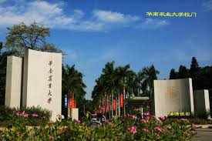

Slide 3
Why UMD?

Slide 4
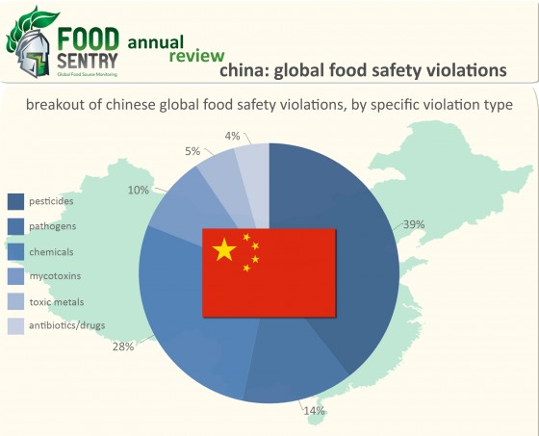
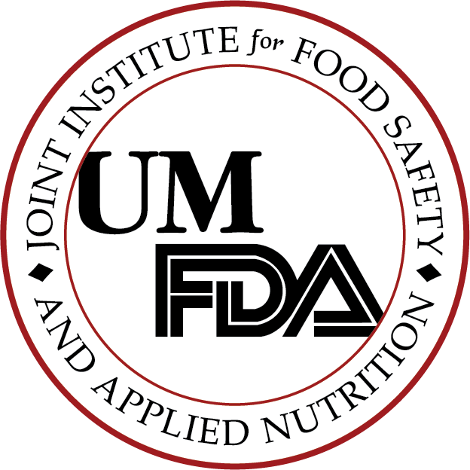
Why UMD?
There are 3 Reasons:
US has one of the best food safety system in the world
UMD is in DC Area and has a lot of cooperation with FDA &USDA in Food safety field. (For example: JIFSAN, CFS3)
2+2 program in UMD is friendly and mature.

Slide 5
Life in the MD (problems)
Academic stuff and career: totally difference from China (4 year plan, language, lab, internship…)
Leisure life: Culture gap, homesick, lonely
View from my first apartment

Slide 6
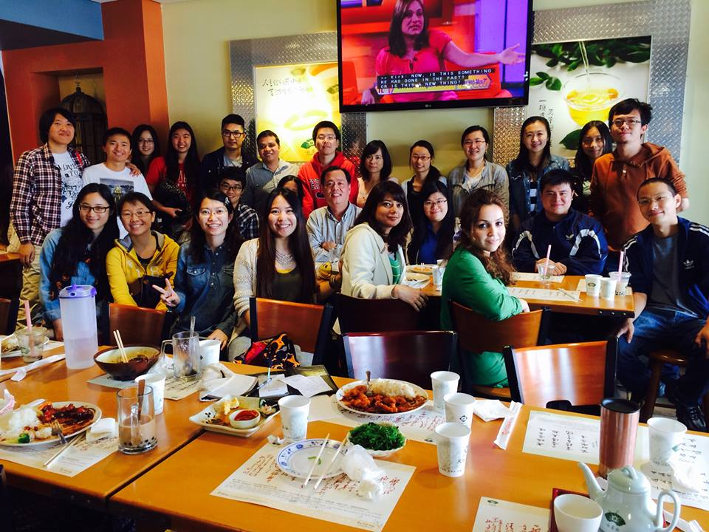
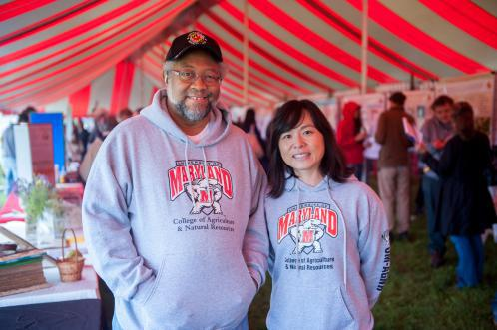
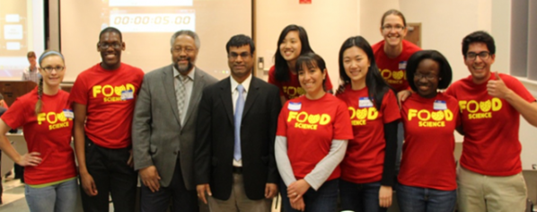
Life became better (Academic and Career)
Faculty and senior 2+2 students helping
Not only in Academic questions but also the career questions
In the end, I decided to combine my math skill and science skill to improve the food safety in China

Slide 7
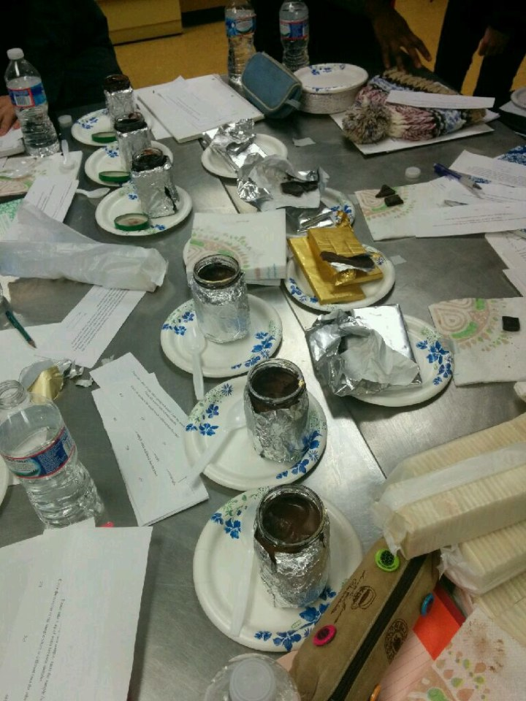
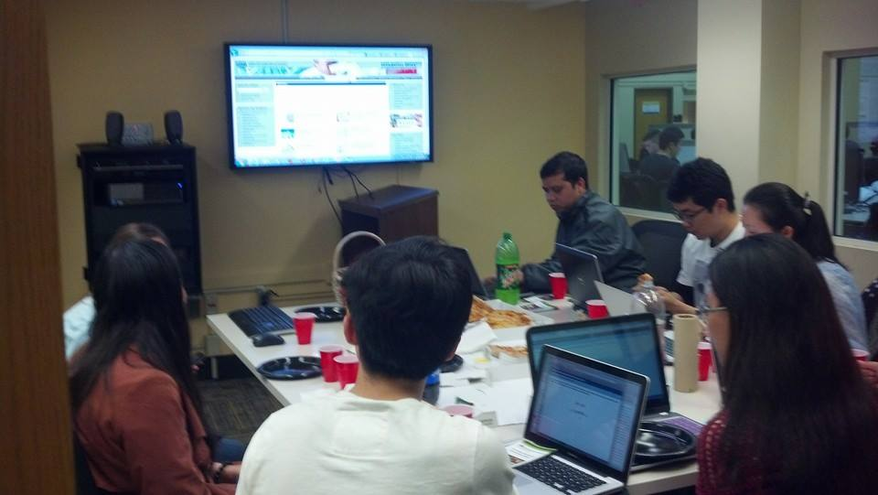
Everything became better! (Labs and Intern)
Great Lab in UMD in food science and our professor also support us to take a visit to USDA Research Center’s Lab
USDA Food Safety Research Information Office Internship

Slide 8
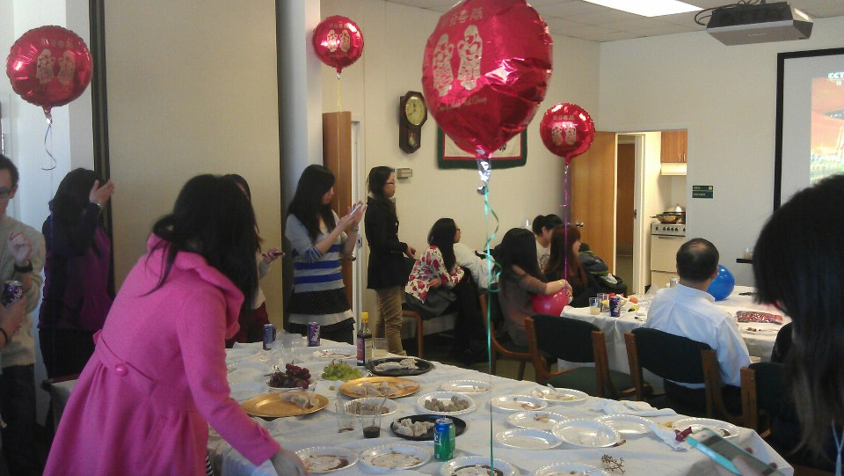
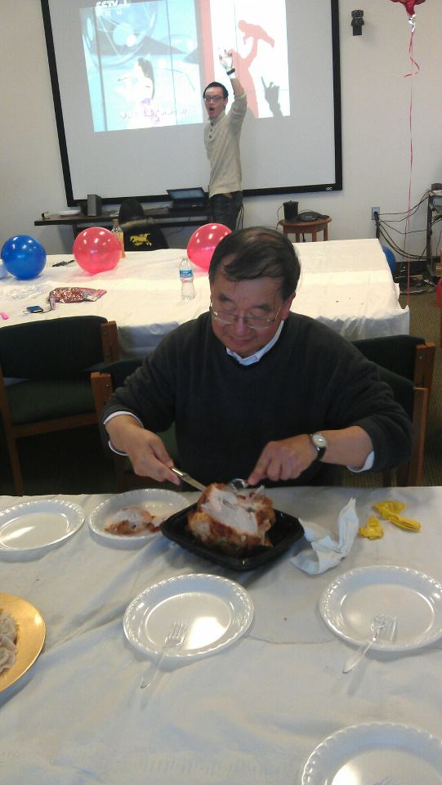
Everything became better! (Leisure Life)

Slide 9
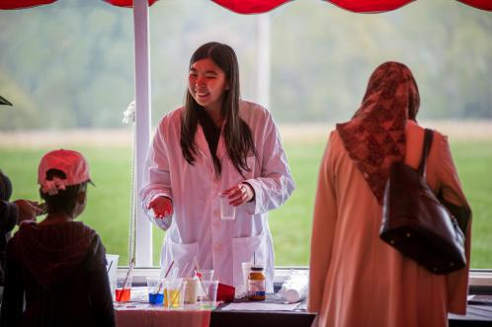
Graduation and work to help new students

Slide 10
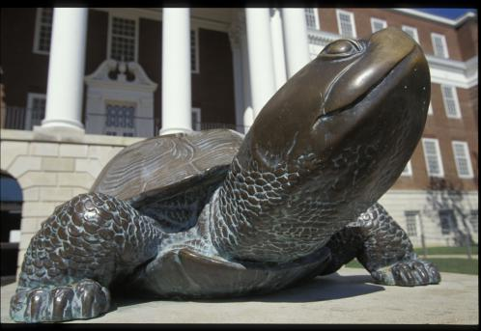
Thank you! Go Terp!

